Slide 1


Slide 2
Vision
Making Wallonia a connected and smart territory,
where digital companies are recognized as global leaders
and drivers of a successful industrial transformation,
and where digital innovation works for high quality education,
open public services and the well-being of citizens.
https://vimeo.com/155558326

Slide 3


Strategic objective 3.1
Accelerate the digitalization and the openness
of the public services
Development axes :
  3.1.1. Develop the digital expertise of public sector employees.
  3.1.2. Develop the culture of data and implement a strategy to open public data.
  3.1.3. Develop a digital administration with high added value, focused on customer’s uses and services.

Slide 4
Actions already engaged
  Open Data. Datasets coming from different levels of public services, with significant inputs from the geoportal and IWEPS.
  data.digitalwallonia.be
  PSI directive. Transcription by the Walloon Governement is done. Licences // federal model.
  www.digitalwallonia.be/decret-open-data
  Public innovation. The Hackathon Citizens of Wallonia, dedicated to smart cities, aims to support and enhance projects developing applications, services or interactive data visualisation, reusing or facilitating the reuse of public data. 2nd edition on March 10-12, 2017 .
  www.digitalwallonia.be/citizens-of-wallonia

Slide 5
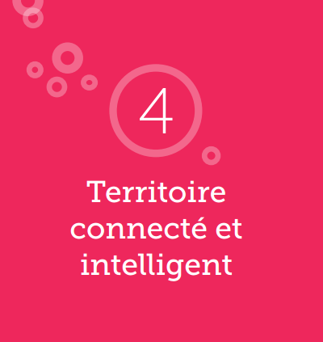

Strategic objective 4.2
Encourage the cutting-edge digital tools across the Wallonia region.
Development axes :
  4.2.1. Multiply open places for digital acculturation and experimentation.
  4.2.2. Push smart cities in a "Smart Region" vision.
  4.2.3. Structure Wallonia's e-health vision on clear priorities, with the support of the Walloon Health Network (Réseau Santé Walloon).

Slide 6
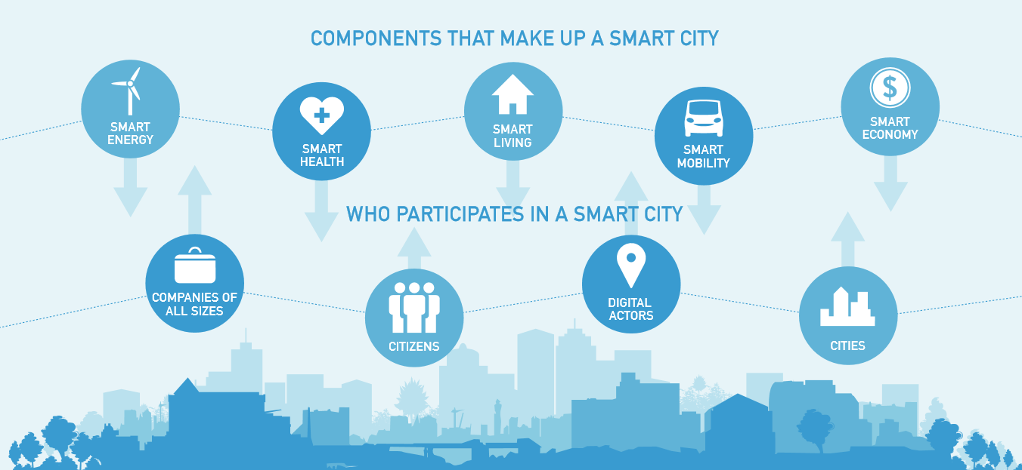
Actions already engaged
  Smart Region initiative. “smart cities” approach on a regional scale to enable a genuine impact on the socio-economic development of urban ecosystems. In collaboration with the 5 major cities of Wallonia.

Slide 7

Digital Wallonia:
Strategy for Smart Region

Slide 8

Theme / Goals/ Focus / Measures
  Theme 4 of the DSP : « Digital Territory»
  It should be considered as a real competitive factor. Connected to high speed and smart, the territory offers unlimited access to digital usages and acts as a catalyst for industrial and economic development.
  Strategic goal 4.2
  Foster uses of advanced digital all over Wallonia.
  Development focus 4.2.2
  Enrol Smart Cities in a Smart Region vision.

Slide 9
3 specific « Smart cities » measures
  M 34. Share resources and ensure the consistency of initiatives over a virtual platform and a physical forum.
  M 35. Accelerate Smart Cities projects with a supportive regulatory environment (innovative public procurement and Open Data) and innovative governance.
  M 36. Implement a supportive environment for the development, test and deployment of Smart cities initiatives at regional scale.

Slide 10
Smart City : Context
Currently half of the world population lives in urban areas.
  66 % across the EU
  90 % in Belgium
  The population in Belgium will grow from 11 millions to 12,7 millions in 2030. This increase in population (urban) brings many challenges :
      Mobility
      Energy
      Waste
      Governance
      Resources
      Lodging
      Living together
In Wallonia, it is considered necessary the creation of 350 000 new dwellings for 2040.
Besides the 5 largest cities in Wallonia (Charleroi, Liege, Mons, Namur, Tournai), and compared with large capital of Europe, an holistic regional approach make more sense then multiply local initiatives (economy of scale).

Slide 11
Smart City : Definition
The concept of « Smart City » is linked with the « Intelligent City » and the « Digital City »

Slide 12
Why a strategy for Smart Region?
Context and issues

Slide 13
Proliferation of initiatives
Often characterized by technological logic and not focus on the uses and services (and on citizen)
.
Risk of decommissioning and bypass of the public action
Operational concerns about projects sometimes considered difficult to control on technical, financial and human aspects
Public authorities are facing digital issues
Lack of data mining culture and uncertainty about data valuation.
Lack of visibility for digital projects by the citizen who become also a digital player
Challenges in relation with the internal organization leading to always allocating any digital projects to the IT department.
Importance of cultural distribution and regulatory constraints that do not facilitate the transition to an open innovation posture
Lack of tools in terms of benchmarking and ex-ante et ex-post assessment to optimize investments

Slide 14


Systematically favor a holistic approach centered on the uses and services to use digital industry as an accelerator for the public action
Switch to a logic of sharing and exchange by documenting any achievements through online tools and dedicated websites
Leader – Facilitator - Assessor Model
Transforming data as a true decision-driven capital at the service of territorial intelligence
Open services and involvement of citizens, considered as "allies" in the design and deployment services process
Momentum
For a
Smart Region
"Infusing digital" in all departments to develop a real reflex and rely on the Digital Wallonia regional brand
Rely on assessment and management tools in order to capitalize and share best practices, and make the best out of local digital projects
Switching from a "provider" to a “partners” vision over a new 4P dimension (Public Private Partnership + Population)

Slide 15
Balancing a dual approach to reduce potential friction zones
Vision régionale
Regional approach
Local approach

Slide 16





Teaming up
Regional
government
Smart Region
Advisers
Large businesses
Core Team
Smart cities

Slide 17
Momentum for a Smart Region
Smart
Energy
Smart
Health
Smart
Living
Smart
Mobility
Smart
Economy
Upright themes
for
Smart
Region
SME
Businesses
Large companies
Startup
Smart Region Advisers
Digital Wallonia
Core Team Smart cities of 5 largest cities
« Intermediate » (second-tier) cities

Slide 18






Momentum for a Smart Region
A three-dimensional model
Smart Health
Smart Economy
Smart Living
Smart Mobility
Smart Energy
Businesses
(Large companie, SME, Start’ups)
Call for projects
Implementation
Assessment/D.&C.
Monitoring/Adjust.
Strategy
« Enablers »
Smart Region Advisers
Top-down/Bottom-up
Strategic focus
Core Team Smart Cities
(5 largest cities, second-tier, rural)
Time (Phases)

Slide 19
How to turn this Smart Region strategy into reality?
  Identify the needs and constraints expressed by the Walloon cities in a perspective of sharing and pooling of experience
  Activate the “Advisors” to target their action in the framework of performance agreements serving the Smart Region strategy
  Enable the emergence of Smart Region projects in different vertical themes prioritized by cities
  Promote innovative modes of cooperation with enterprises by facilitating the transfer of skills to the benefit of cities
  Develop training for elected officials and agents within cities to increase digital skills

Slide 20
How to turn this Smart Region strategy into reality?
  Tangible, open, scalable
  Public / private partnerships, a network that the local can connect to
  In a spirit of pooling / replicability
  Complementarity
  Focus on accelerate services
  An attractive force enabling “plug-in's”
  Take citizen issues in consideration
  Exploitation of data in back office

Slide 21



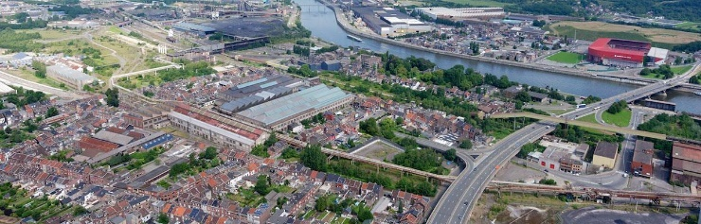
In line with EU SCC approach
Market Place of the European Innovation Partnership on Smart Cities and Communities
… and many more.
Cross H2020
SCC Projects, …

Slide 22
Thank you !
Stéphane Vince
stephane.vince@adn.aei.be
Pascal Poty
pascal.poty@adn.aei.be

